Slide 1


Slide 2


C# Generics

Slide 3
c# Generics
Generics provides the type safe code with re-usability like as algorithm. In algorithms such as sorting, searching, comparing etc. you don’t specify what data type(s) the algorithm operates on. The algorithm can be operates with any types of data. In the same way Generics operate, you can provide different data type to Generics. For example, a sorting algorithm can operates on integer type, decimal type, string type, DateTime type etc.

Slide 4
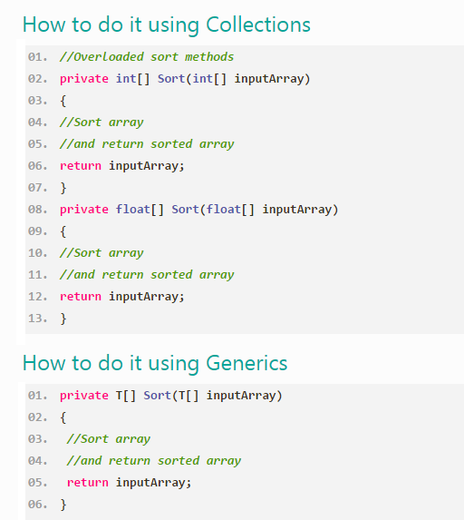

Slide 5
Collections
Generics
ArrayList
List
HashTable
Dictionary

Slide 6
ArrayList
ArrayList is one of the most flexible data structure from CSharp Collections. ArrayList contains a simple list of values. ArrayList implements the IList interface using an array and very easily we can add , insert , delete , view etc. It is very flexible because we can add without any size information , that is it will grow dynamically and also shrink.
The commonly used functions in ArrayList are :
Add
Insert
Remove
RemoveAt
Sort

Slide 7
How to add an Item in an ArrayList ?
Syntax : ArrayList.add(object)
object : The Item to be add the ArrayList
ArrayList arr;
arr.Add("Item1");
How to Insert an Item in an ArrayList ?
Syntax : ArrayList.insert(index,object)
index : The position of the item in an ArrayList
object : The Item to be add the ArrayList
ArrayList arr;
arr.Insert(3, "Item3");

Slide 8
How to remove an item from arrayList ?
Syntax : ArrayList.Remove(object)
object : The Item to be add the ArrayList
arr.Remove("item2")
How to remove an item in a specified position from an ArrayList ?
Syntax : ArrayList.RemoveAt(index)
index : the position of an item to remove from an ArrayList
ItemList.RemoveAt(2)
How to sort ArrayList ?
Syntax : ArrayList.Sort()

Slide 9
C# HashTable
Hashtable in C# represents a collection of key/value pairs which maps keys to value. Any non-null object can be used as a key but a value can. We can retrieve items from hashTable to provide the key . Both keys and values are Objects.
The commonly used functions in Hashtable are :
Add
ContainsKey
ContainsValue
Remove

Slide 10
Add : To add a pair of value in HashTable
Syntax : HashTable.Add(Key,Value)
Key : The Key value
Value : The value of corresponding key
Hashtable ht;
ht.Add("1", "Sunday");
ContainsKey : Check if a specified key exist or not
Synatx : bool HashTable.ContainsKey(key)
Key : The Key value for search in HahTable
Returns : return true if item exist else false
ht.Contains("1");

Slide 11
ContainsValue : Check the specified Value exist in HashTable
Synatx : bool HashTable.ContainsValue(Value)
Value : Search the specified Value in HashTable
Returns : return true if item exist else false
ht.ContainsValue("Sunday")
Remove : Remove the specified Key and corresponding Value
Syntax : HashTable.Remove(Key)
Key : The key of the element to remove
ht.Remove("1");

Slide 12
List < T > Class
The Collection classes are a group of classes designed specifically for grouping together objects and performing tasks on them. List class is a collection and defined in the System.Collections.Generic namespace.
The commonly used functions in List are :
Add
Insert
Remove
search
The C# List < T > class represents a strongly typed list of objects that can be accessed by index and it supports storing values of a specific type without casting to or from object.
List < T >
The parameter T is the type of elements in the list.

Slide 13
How to add items in a List collection
Add Integer values in the List collection
List<int> iList = new List<int>();
iList.Add(2);
iList.Add(3);
iList.Add(5);
iList.Add(7);
Add String values in the List
List<string> colors = new List<string>();
colors.Add("Red");
colors.Add("Blue");
colors.Add("Green");

Slide 14
How to retrieve items from List collection
You can retrieve items from List collection by using for loops.
foreach (string color in colors)
{
MessageBox.Show(color);
}
How to Insert items to List collection
You can use insert(index,item) method to insert an in the
specified index.
colors.Insert(1, "violet");

Slide 15
How to remove an item from List collection ?
Remove() can use to remove item from List collection.
colors.Remove("violet");
How to count number of items in a List ?
You can use count property to know the number of items in the List collection or the length of a C# List
colors.Count

Slide 16
C# Dictionary
A Dictionary class is a data structure that represents a collection of keys and values pair of data. The key is identical in a key-value pair and it can have at most one value in the dictionary, but a value can be associated with many different keys.
Syntax:
Dictionary< TKey , TValue >
Parameters : TKey - The type of the keys in the dictionary.
TValue - The type of the values in the dictionary.
e.g.
Dictionary<string, string>
Dictionary<string, int>

Slide 17
Adding Values to Dictionary
Add method in Dictionary takes two parameters, one for the key and one for the value.
Syntax:
Dictionary_Name.Add(TKey key,TValue value)
e.g.
Dictionary<string, int> dict = new Dictionary<string, int>(); dict.Add("one", 1);
dict.Add("two", 2);
dict.Add("three", 3);
dict.Add("four", 4);

Slide 18
Search for a Key
We can search a Key in Dictionary by using the ContainsKey method to test whether a key exists or not. ContainsKey computes the hashcode for its argument and checks the internal structures in the Dictionary.
if (dict.ContainsKey("four") == true) {
MessageBox.Show(dict["four"].ToString ());
} else
{
MessageBox.Show("Key does not exist");
}

Slide 19
C# Dictionary Versus Hashtable
While perform operations Dictionary is faster because there is no boxing/unboxing (valuetypes don't need boxing) while in Hashtable boxing/unboxing (valuetypes need boxing) will happened and which may have memory consumption as well as performance penalties.

Slide 20
C# Dictionary Versus List
Both lists and dictionaries are used to store collections of data. A Dictionary < int, T > and List < T > are similar, both are random access data structures of the .NET framework.
The Dictionary is based on a hash table, that means it uses a hash lookup, which is a rather efficient algorithm to look up things, on the other hand, a list you have to go element by element until it finds the result from beginning to the result each time.

Slide 21
Q&A

